Slide 1

RoboTour
A robot that improves your experience in museums
Notes:
Finn
This is RoboTour. RoboTour is a multi-purpose assistive robot tailored to museum visitors. Our mission is to provide a dynamic cultural experience for museum visitors through 2 unique value propositions:
Robot guiding assistance, for example, RoboTour take me to the newest painting. Where is the Picasso painting. Take me to the toilet?
Elimination of language barriers, RoboTour is a walking tour-guide which provides multi-language support. RoboTour will take you to the exhibitions that you want to see and in your primary language.
As outlined in our project plan, we have achieved 4 key milestones for demo 1: Basic Robot Building, App-to-Robot Communication, Basic UI Designs, and Basic Collision Avoidance.
For each of these milestone, our members will also talk about what’s next steps.

Slide 2
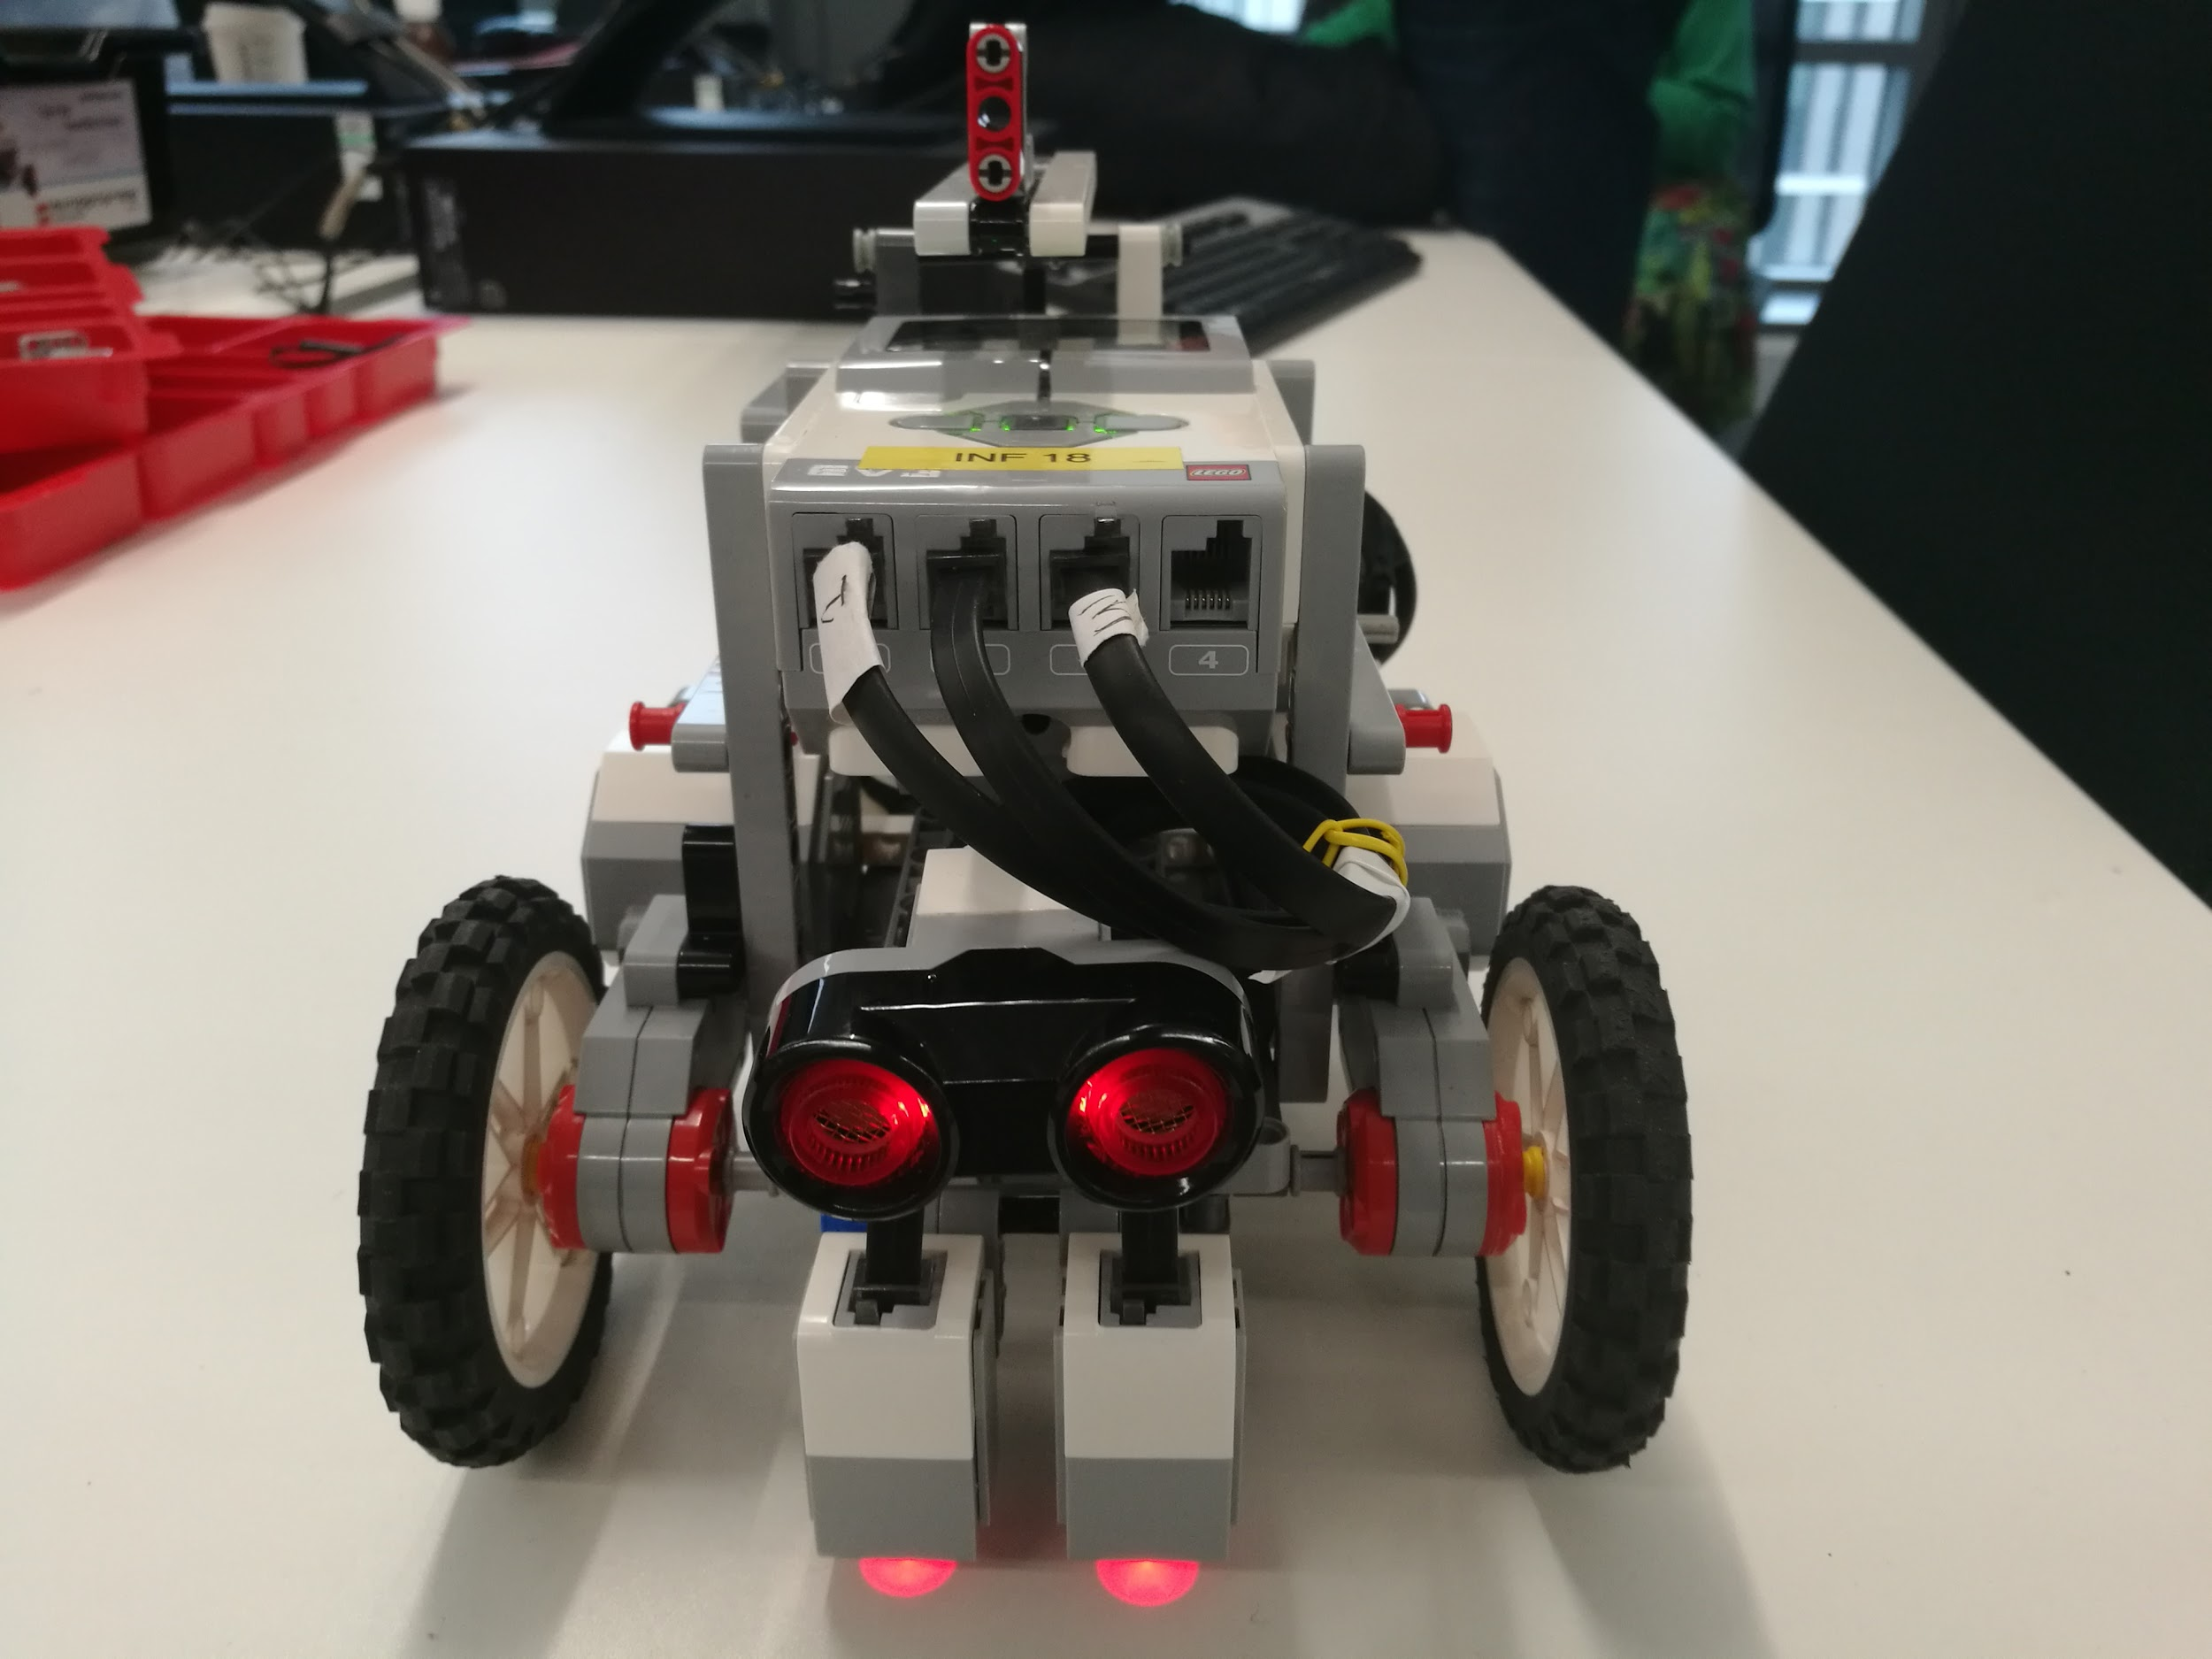
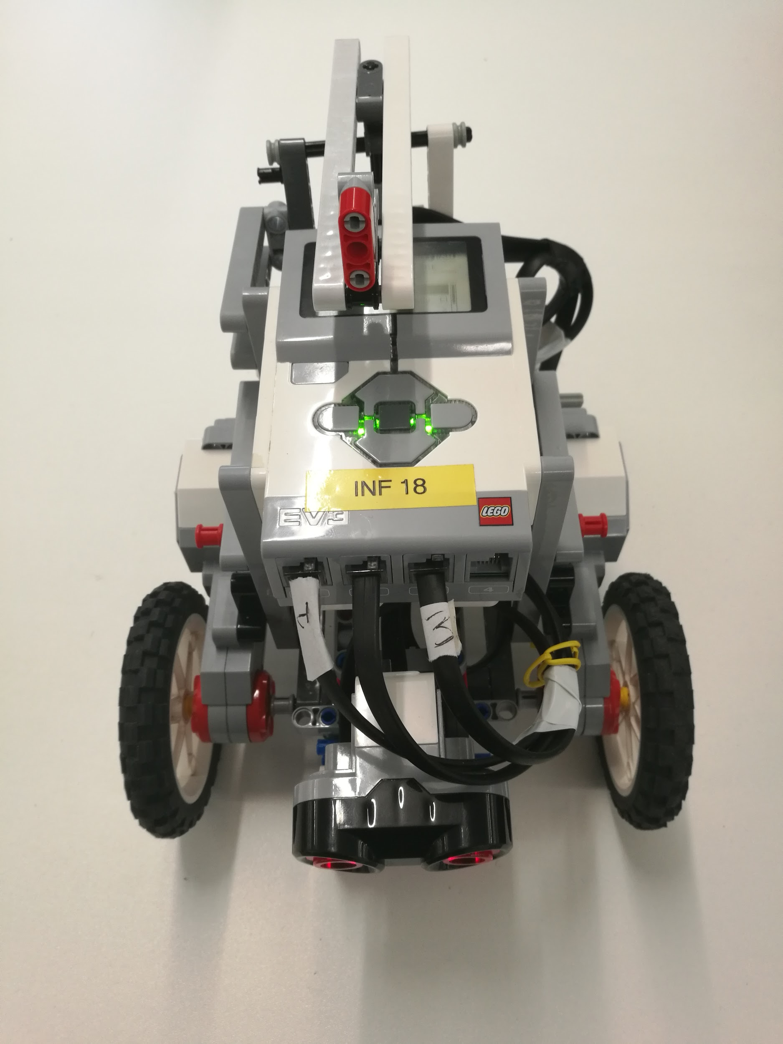
Basic Robot Building
Fig 1: Front
Fig 2: Top
Notes:
Physical structure: the robot has 4 wheels, 2 of them are connected to motors, the rest 2 can move independently and are only used for balance and stability. This kind of build allows the robot to rotate in place and, most importantly, move with precision. There is also a motor directly underneath the brick which controls this pointer. The pointer will be used for pointing at exhibits while guiding tourists. Since pointer’s precision is important, the pointing mechanism is built so that no external forces can accidentally move the motor and confuse the robot about the pointer’s position. That’s all about motors, now moving on to sensors - we’ve got a lego ultra-sound sensor for basic collision avoidance and 2 colour sensors for smooth line following. This is our current build, but there are some improvements that can be made to it and Michal will talk about that.
Next Steps - Michal:
account for resources used and remaining: new sensors, etc

Slide 3
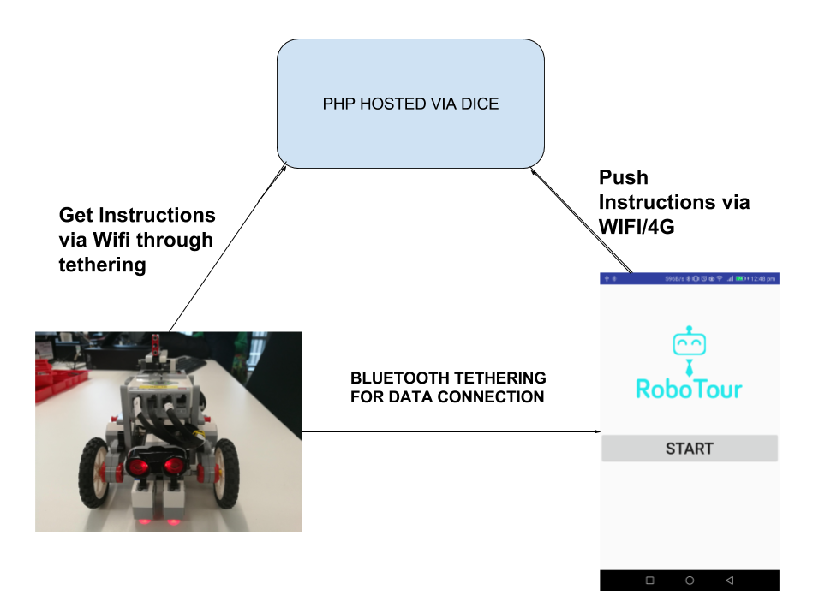
App-to-Robot Communication
Fig 3: Communication diagram
Notes:
Smartphones: 81% of had access to smartphones according
App designed to be easy to use, David will show it
Explain layout of diagram, Using Bluetooth currently, WiFi currently unstable but will investigate
Using a php webpage hosted via dice as this allows more versitlity and opens doors for future improvements, only one bluetooth device connected at a time using bluetooth directly which is a bottleneck.
Approx 3 second delay, but not an issue with the main implementation as the Robot will not receive commands every few seconds like here hence will not be as time sensitive
https://www.cbronline.com/verticals/etail/smartphone-uk/

Slide 4
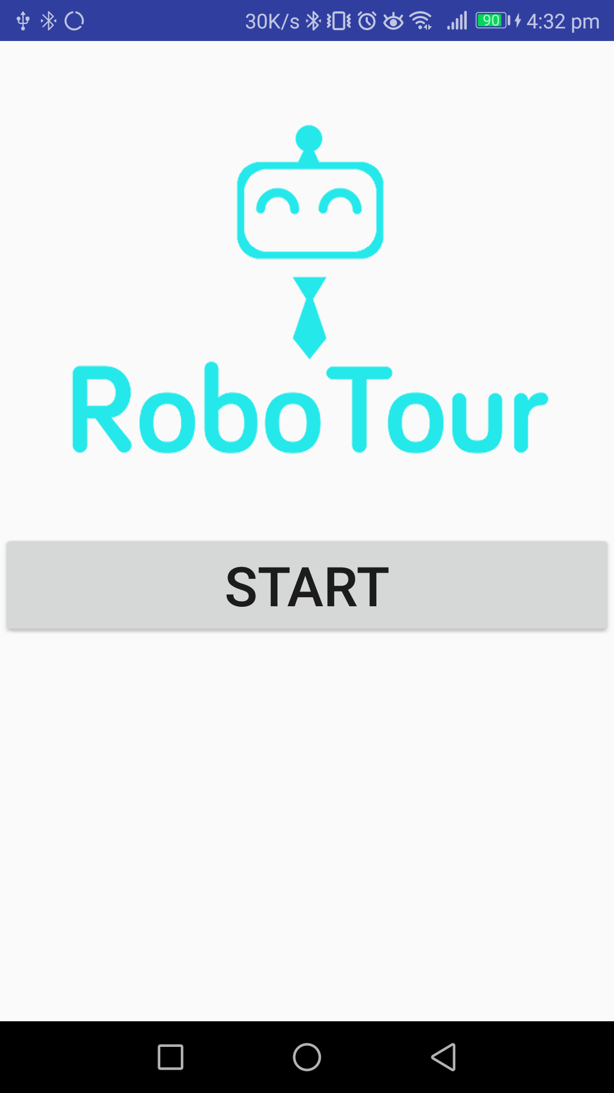
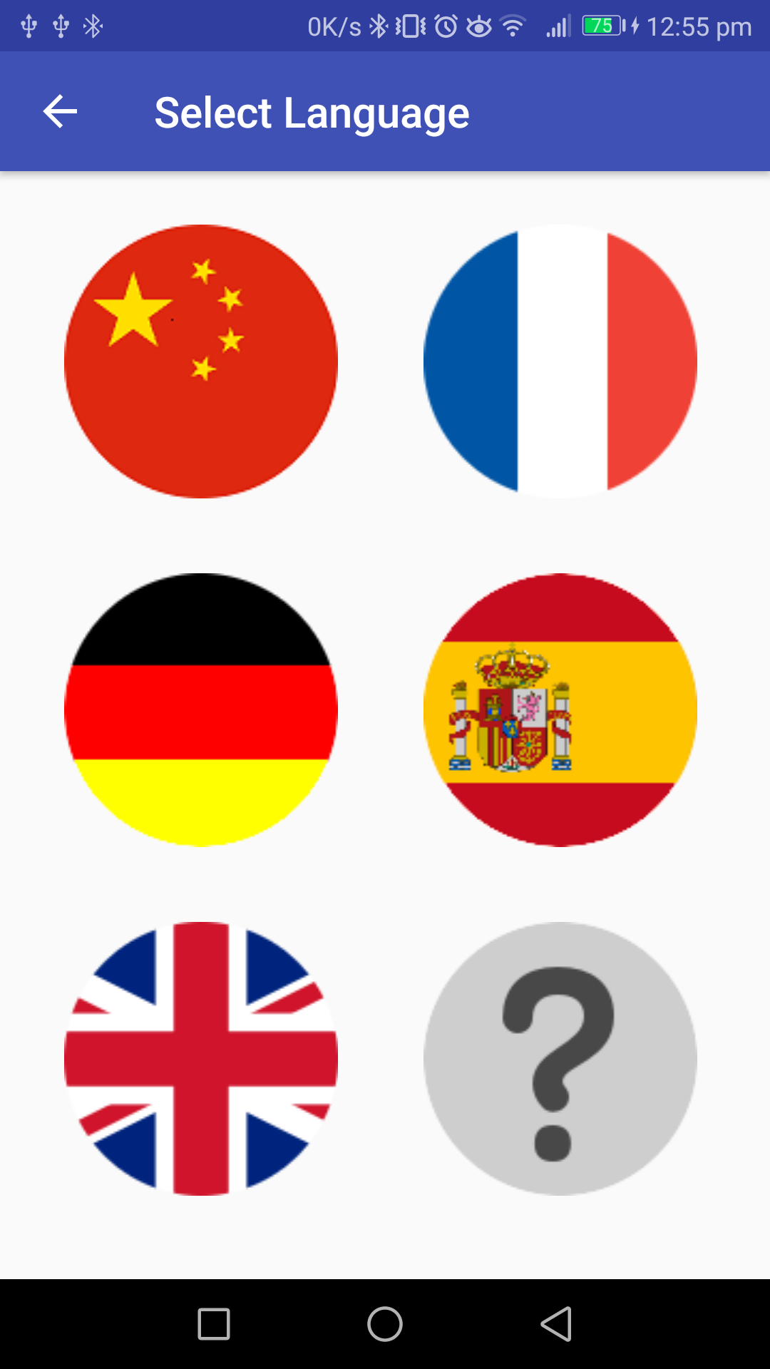
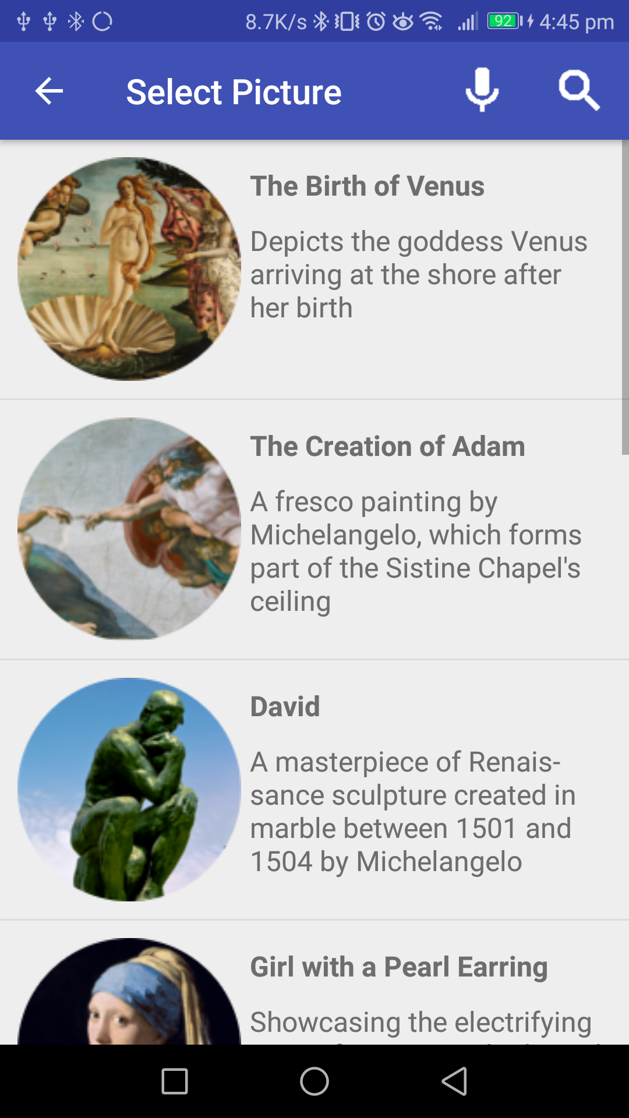
Completed Basic User Interface
Fig 4: Start page
Fig 5: Language selection page
Fig 6: Picture selection page
Notes:
Here we have the completed basic user interface.
Once the user presses the start button they are greeted by a language selection page where they can select the flag of the language they speak.
After the user has selected their language they get to the picture selection page where they can select the pictures they want to go to.
If they don’t understand any of the displayed languages they can select the question mark button which offers a minimal text option that can be seen here in figure 8 here...

Slide 5
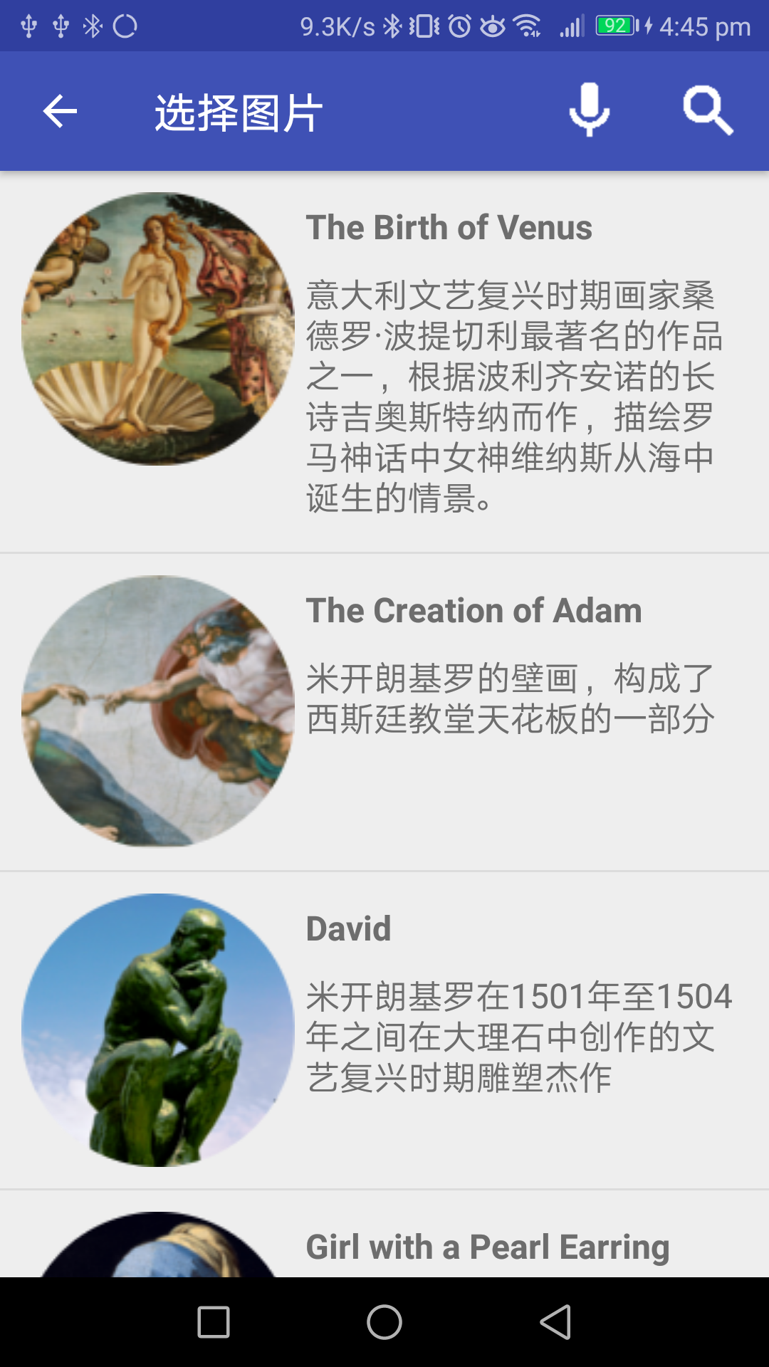
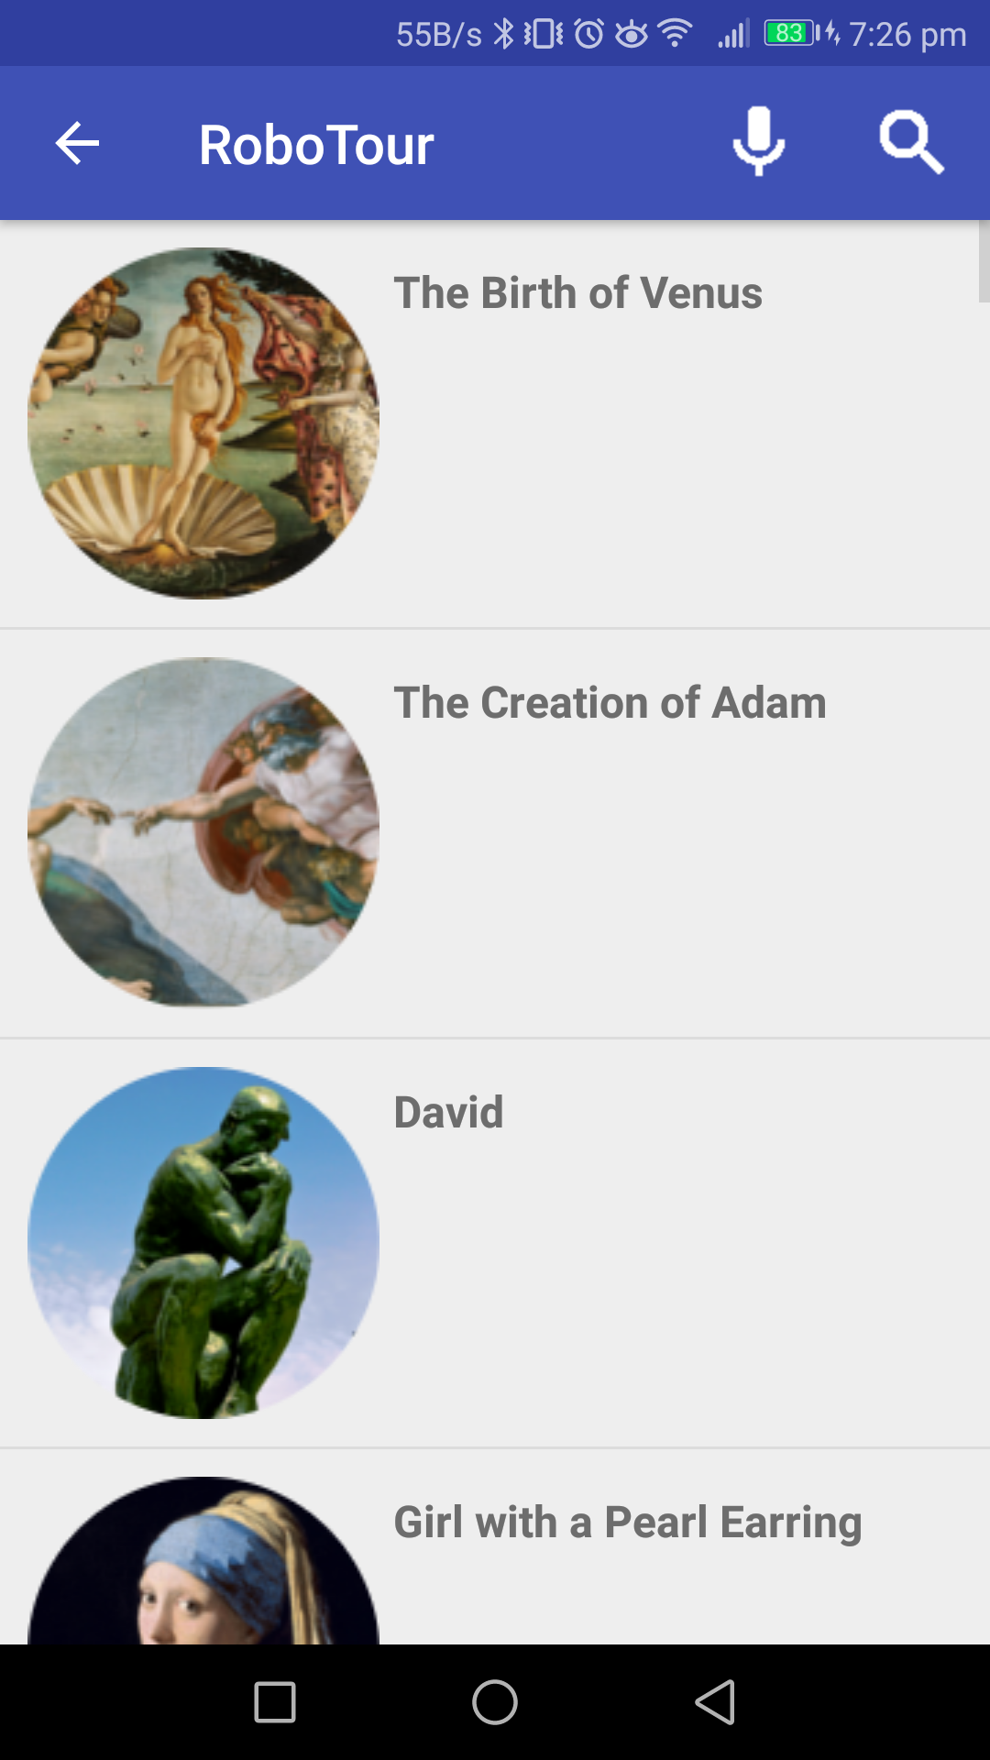
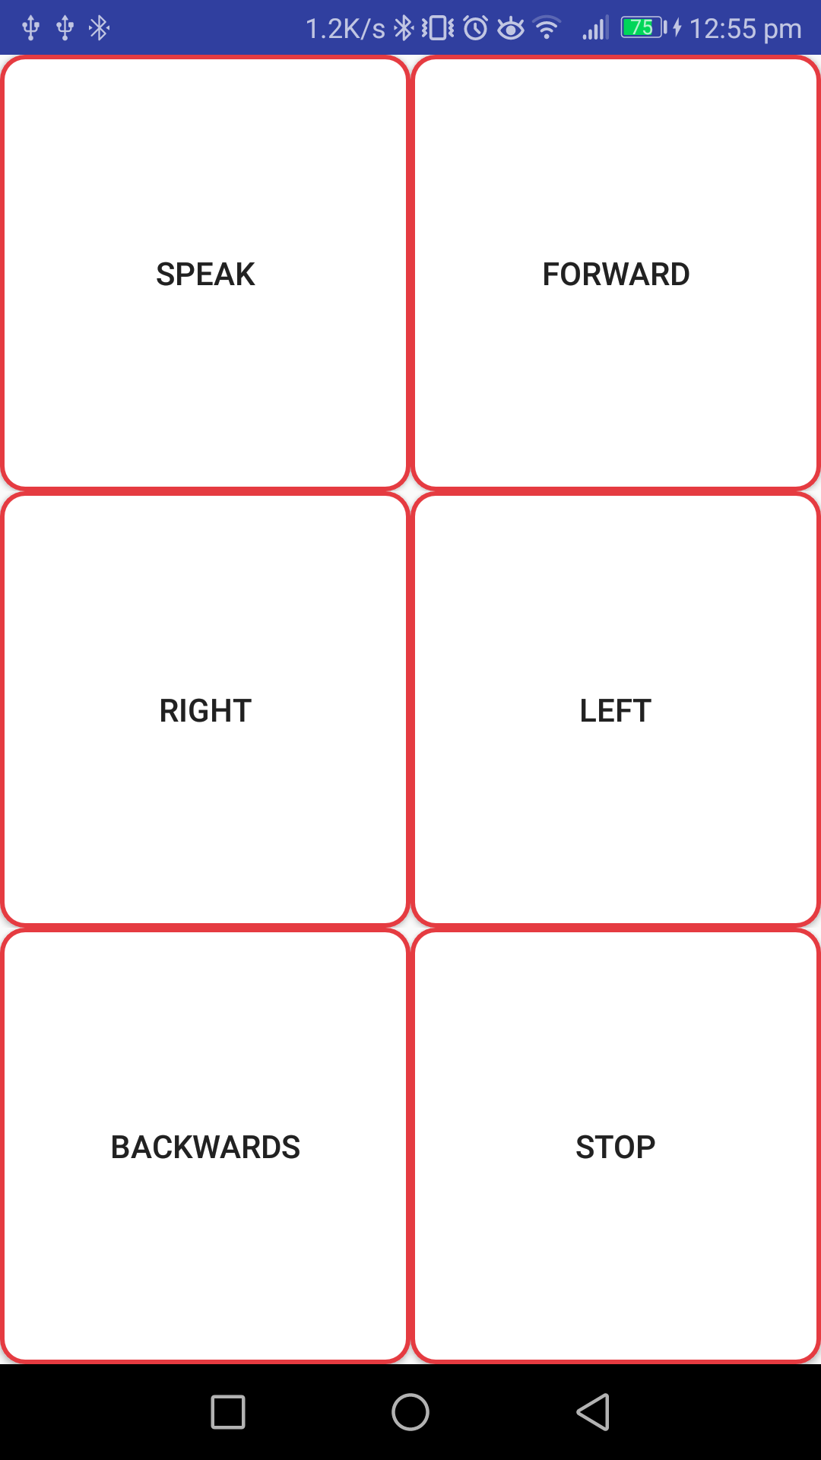
Completed Basic User Interface
Fig 7: Selection page in Chinese
Fig 8: Selection page in no language
Fig 9: Temporary control page
Notes:
We will update this UI when new features need to be implemented.
This last page is a temporary control page which we set up for this demonstration only.
It is accessed by pressing the MainActivity’s start button for 2 seconds. From there you can control the EV3 robot directly.

Slide 6
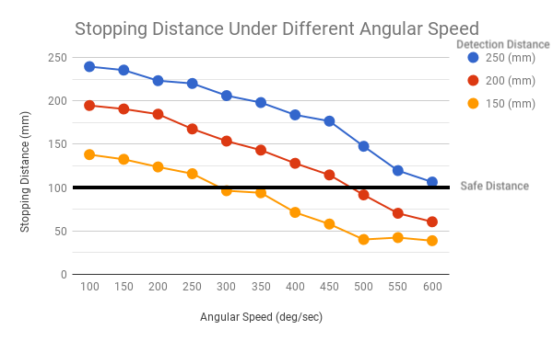
Basic Collision Avoidance
Client Demo 1:
Stop when detects obstacles
Only apply at going forward
Using multithreading
Purpose of the graph:
Stopping D. = -k*Angular Speed + Detection D.
Where k ~ 11
Keep a safe actual stopping distance
Fig 10: Stopping distance under different angular speed in different detection distance
Notes:
We have implemented basic collision avoidance. When the robot is going forwards and detects an obstacle, it will stop. We found that the robot didn’t stop immediately when testing the robot and so we did research to determine how angular speed affects the actual distance the robot will stop at.
We found that there is a linear negative relationship between motor speed and the distance the robot travels after detecting an obstacle. This means that if we want to stop the robot at a safe distance of 100 mm and our angular speed is 600 deg/sec we’ll need to set the distance at which the robot begins stopping at 250 mm.
We believe this is because of the EV3 reaction time, and because we were using passive braking and we hope to reduce this distance travelled by improving the reaction time and changing to active braking.

Slide 7
Live Demonstration
Notes:
David

Slide 8
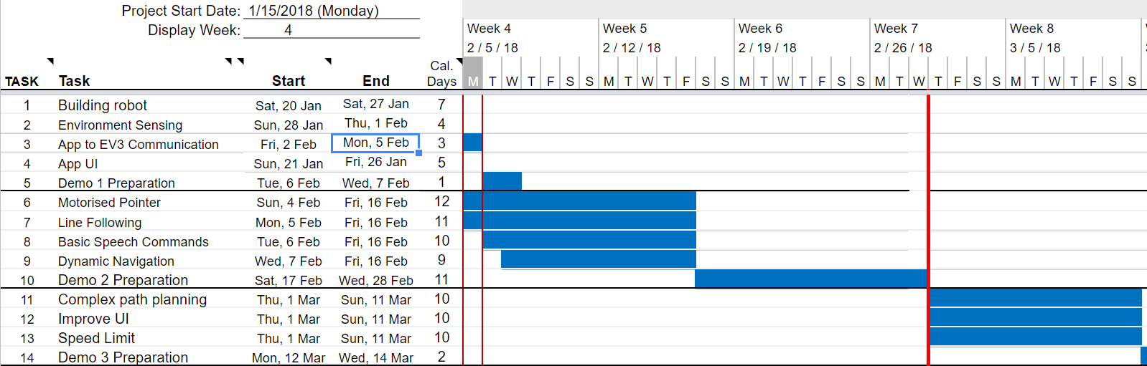
Plans Going Forward - Revised Gantt Chart
Fig 11: Gantt chart
Notes:
- Mariyana still ill and not in Edinburgh - We expected her to be back, but due to medical complications she hasn’t come back yet- hence we need to reshuffle
- We also reshuffled further according to each team members strengths
- We have done this to ensure that we we optimally use our time to produce the best quality work in an efficient manour.

Slide 9
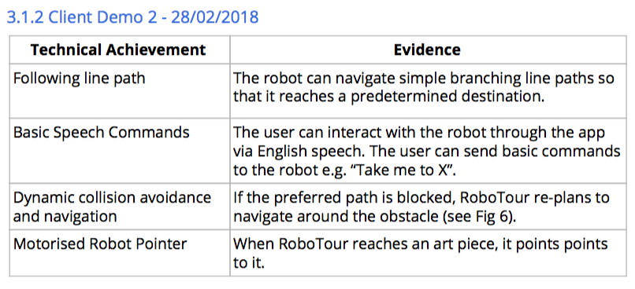
Next Steps
Fig 12: Milestones for next client demo
Notes:
Here we have what we plan to have completed for Demo 2.
Address 4 points
The only difference with this is like Michal said we are building a custom line sensor for this demo.

Slide 10
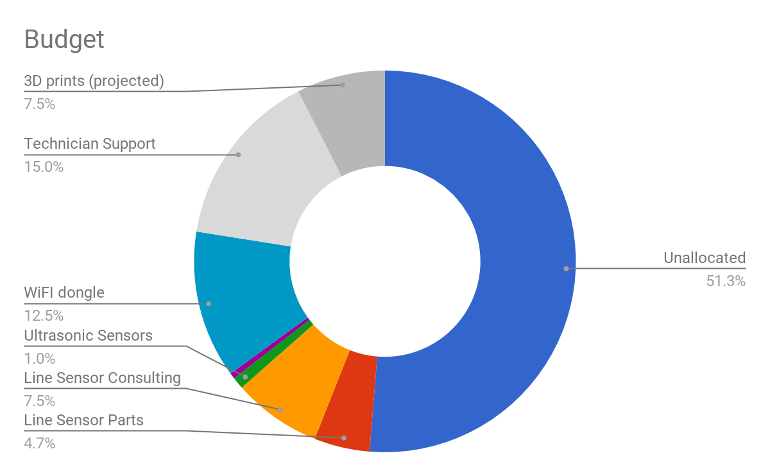
Resources/Member
Time Spent: 68 Remain: 132 (hrs/member)
Guest lectures: 3 (of 6)
Demonstrations 1 (of 4)
Group meetings: 11 (of 25)
Planning and Admin 16 (of 40)
Debugging & Testing: 10 (of 30)
Code Reviews: 2 (of 10)
Robot construction: 5 (of 10)
Code development 20 (of 75)
Money Spent: £23.43 Remain: £176.57
Microcontroller (ATMEGA88A-AU) £2.50
Sensor (KTIR 0711S) £0.00
Sensor (QRE1113GR) £5.64
Crystal (MCRS020000F1) £0.29
Line sensor (Technician Time) £15
Fig 13: Budget pie chart
Notes:
Michal
Main:
Conclusion: We are on schedule to completing tasks because it took us 50 hours/member of work each to get to this point

Slide 11
Thank You
We would like to welcome any questions or suggestions that you may have.
Notes:
We would all like to thank you for listening to our demonstration. We would like to invite you to have a look at our current system and would welcome any questions or suggestions you may have.

